Slide 1
Comprehensive Analysis of Laptop Characteristics and Pricing
Project Workflow
1.Data Cleaning and Preprocessing
2.Exploratory Data Analysis (EDA)
3.Visualization
4.Feature Engineering
5.Analysis and Interpretation
6.Documentation
Student Name : Sathish.k
Program : DA/DS, Milestone-1(Python Data Exploration Project
Date : 10-06-2024

Slide 2
Introduction
Objective:
This project aims to conduct a comprehensive analysis of laptop data to uncover insights about laptop characteristics, performance, and pricing, aiding both consumers and manufacturers.
Dataset Overview:
The dataset includes information on various attributes of laptops such as brand, specifications, and pricing.
Importance:
Understanding data through preprocessing and visualization is
crucial for deriving actionable insights and making informed decisions in the
laptop industry.

Slide 3
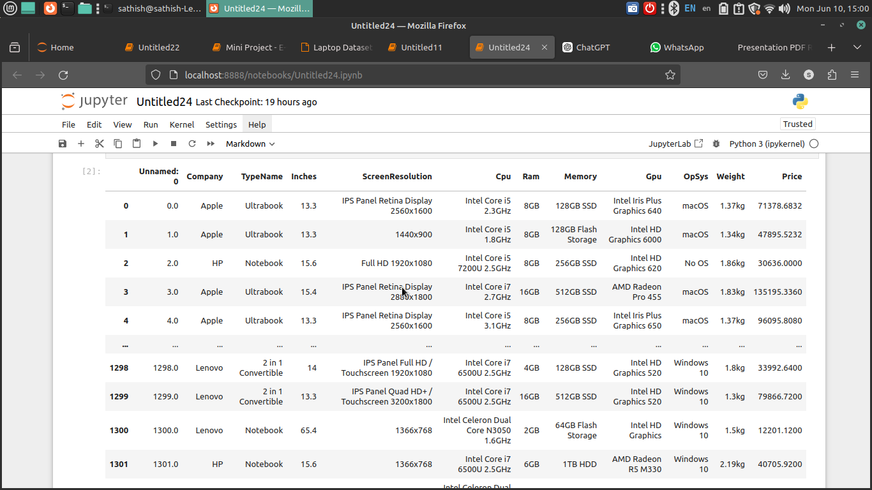
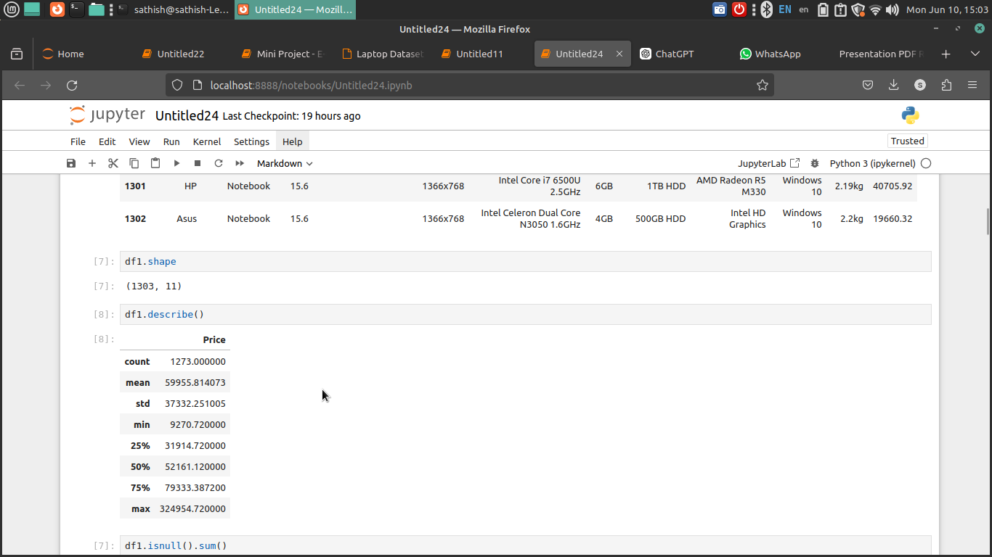
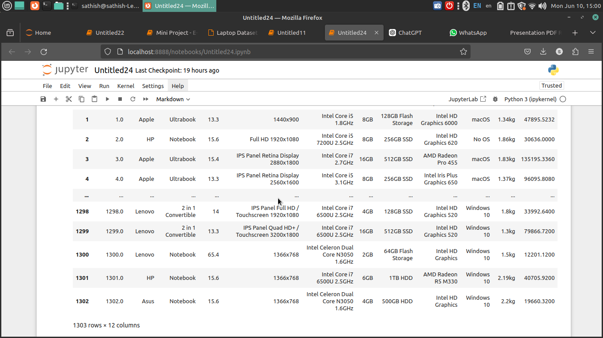
3.Data Understanding

Slide 4
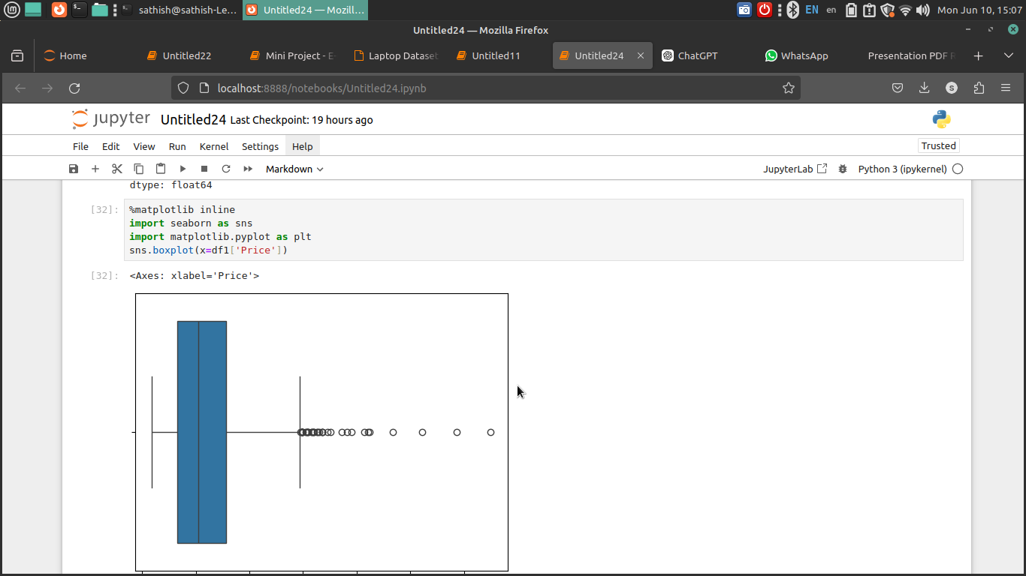
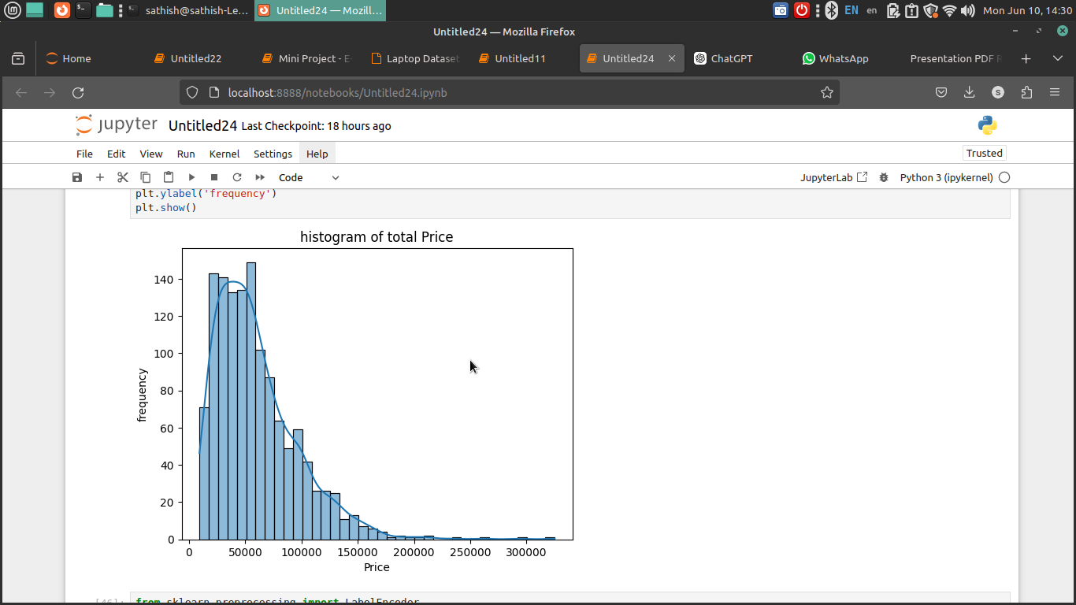
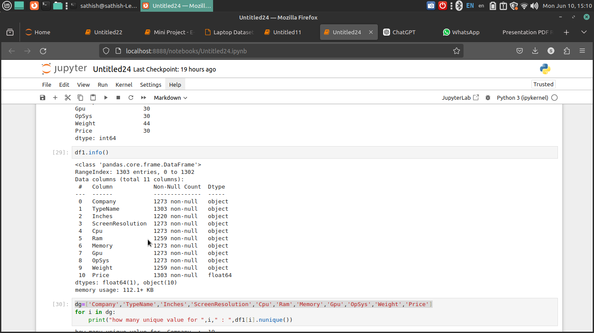
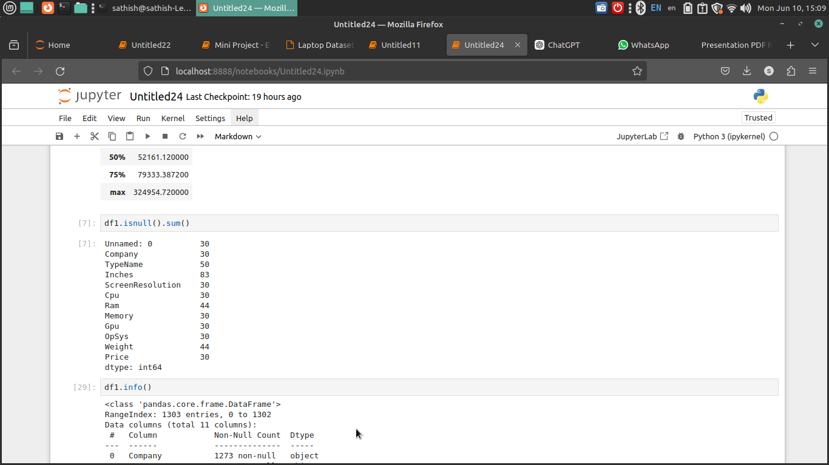
4.Initial Exploration

Slide 5
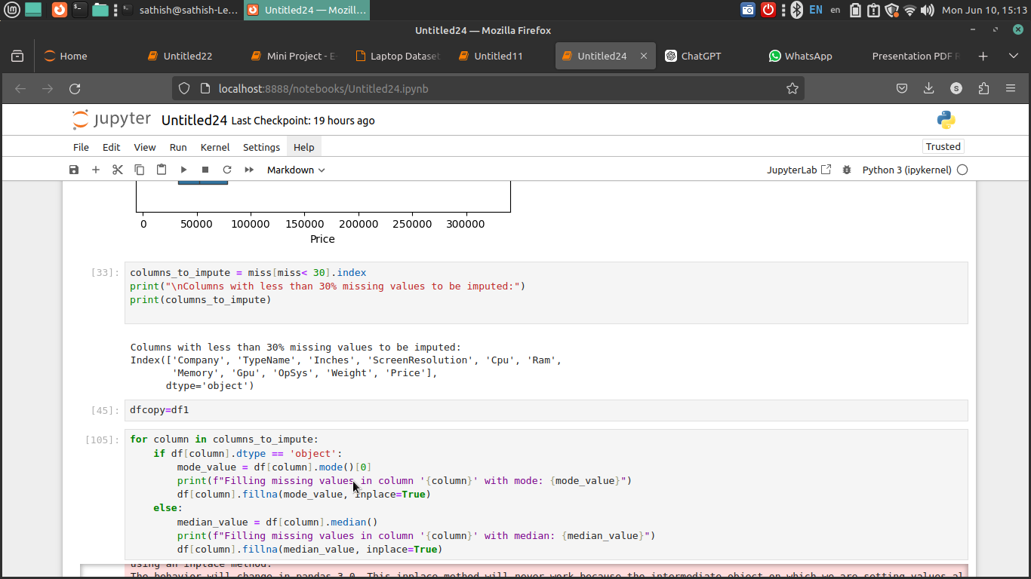
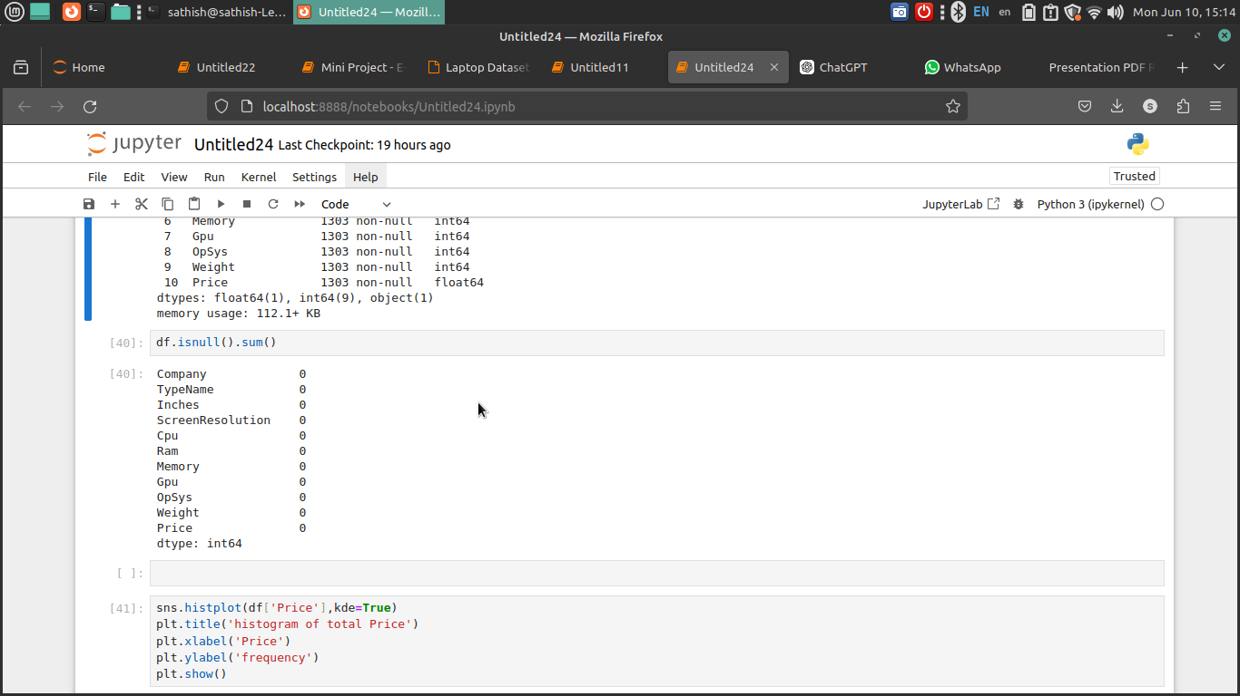
5.Missing Values Handling

Slide 6
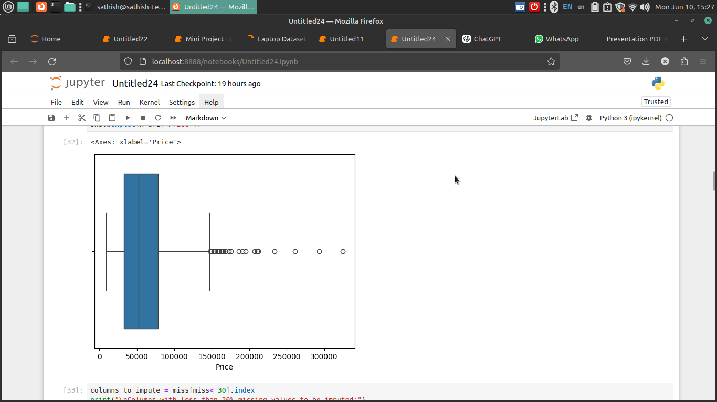
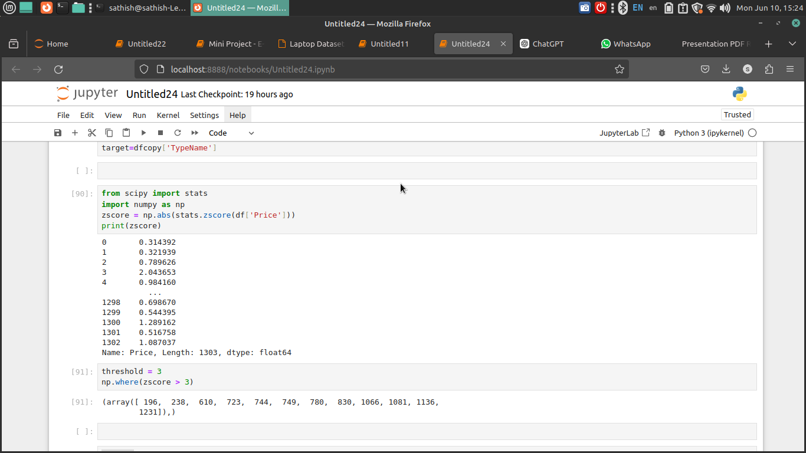
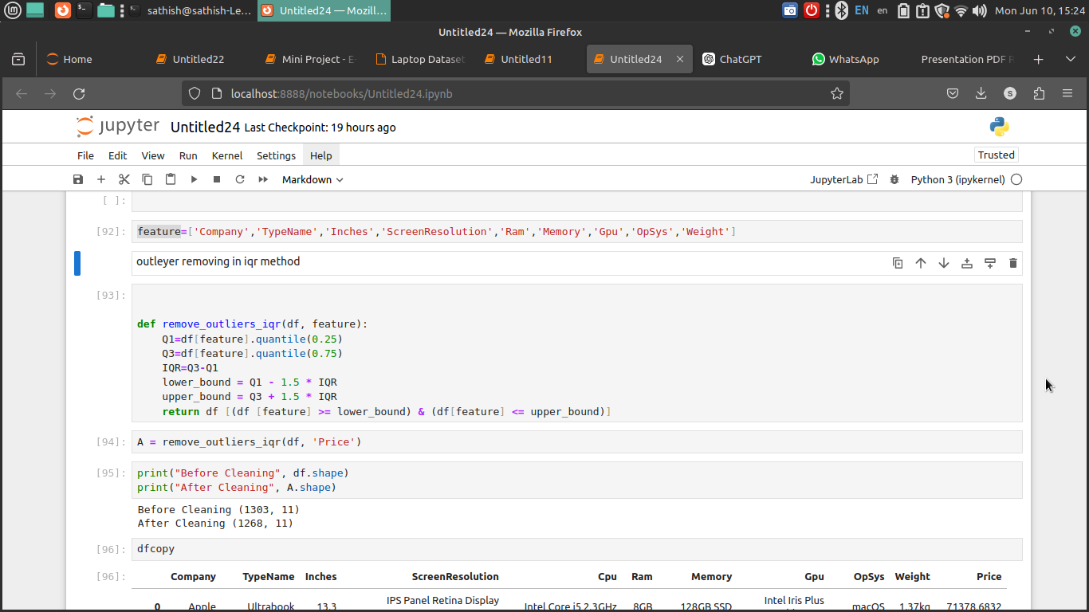
6.Outlier Handling

Slide 7
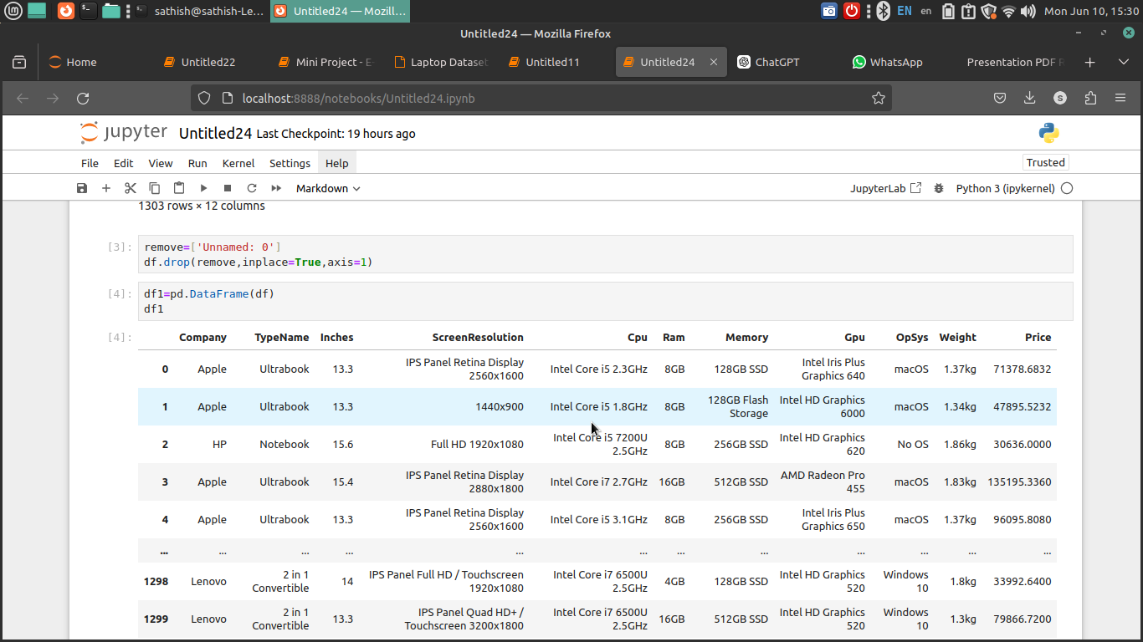
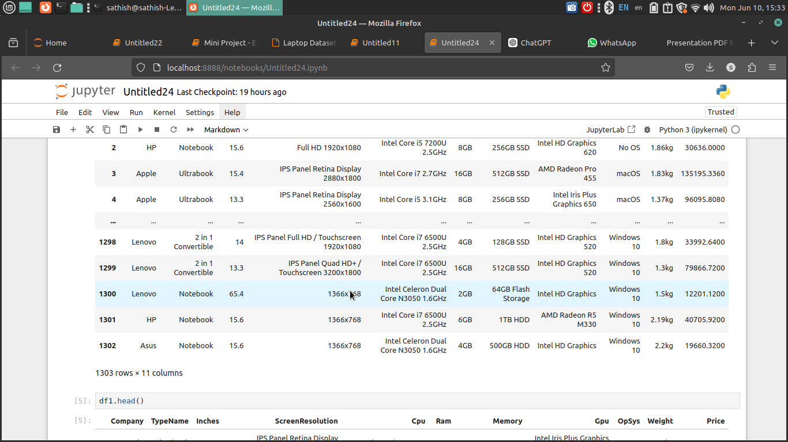
7.Fixing Row and Columns

Slide 8
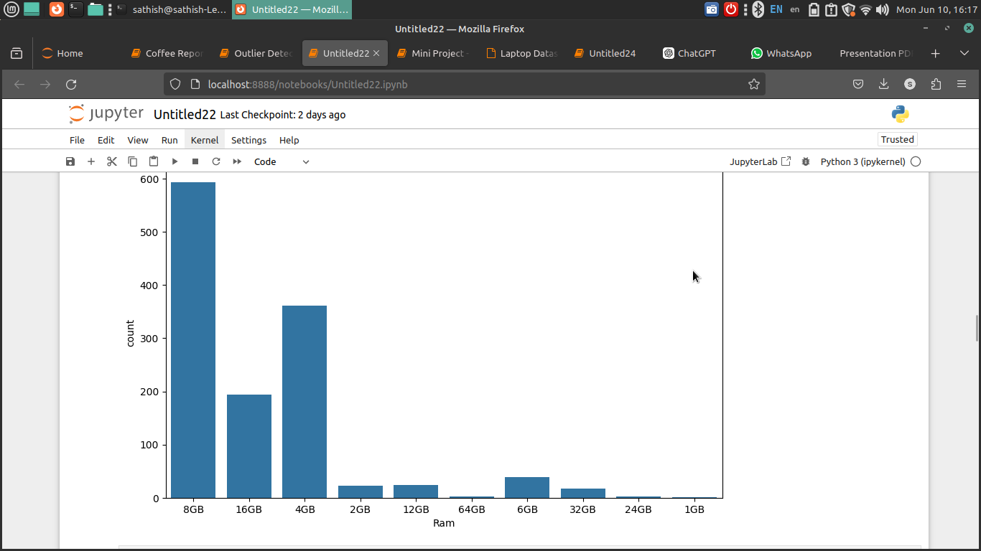
Derived Metrics

Slide 9
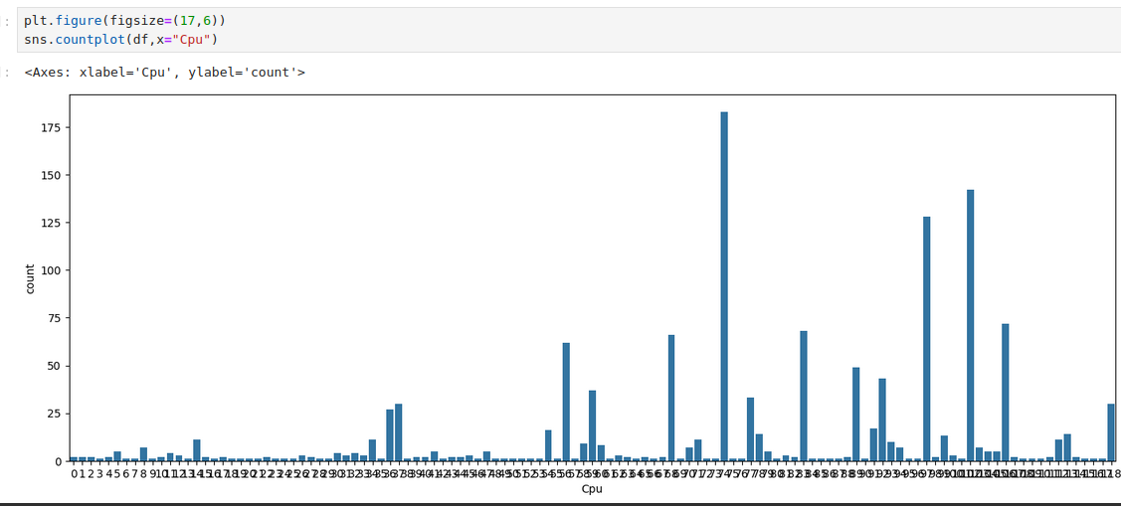
CPU=Intel core i5 7200u 2.5GHz

Slide 10
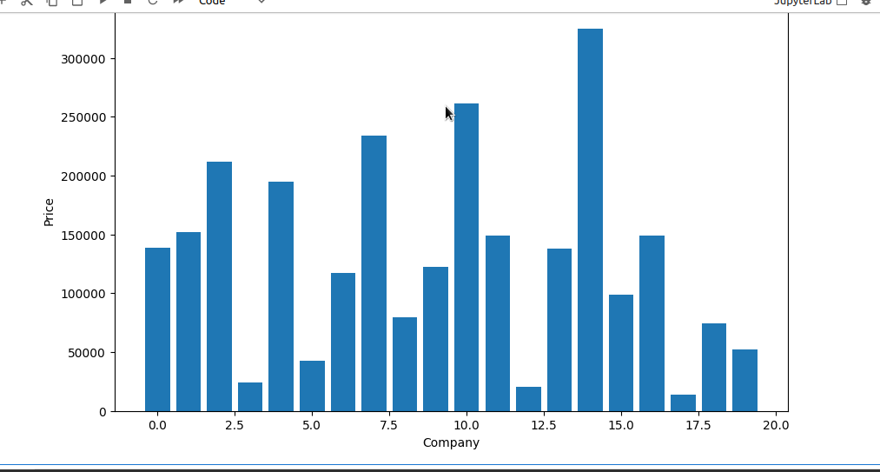
8=Huawei
11=MSI
15=Samsung

Slide 11
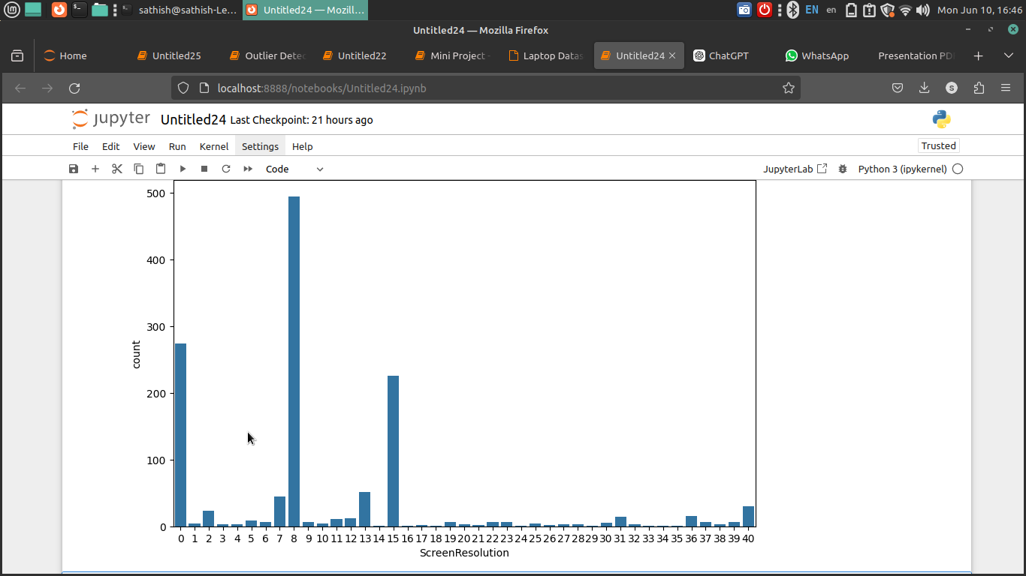
8=IPS Panel Retina Display 2880x1800
0= 1366x768

Slide 12
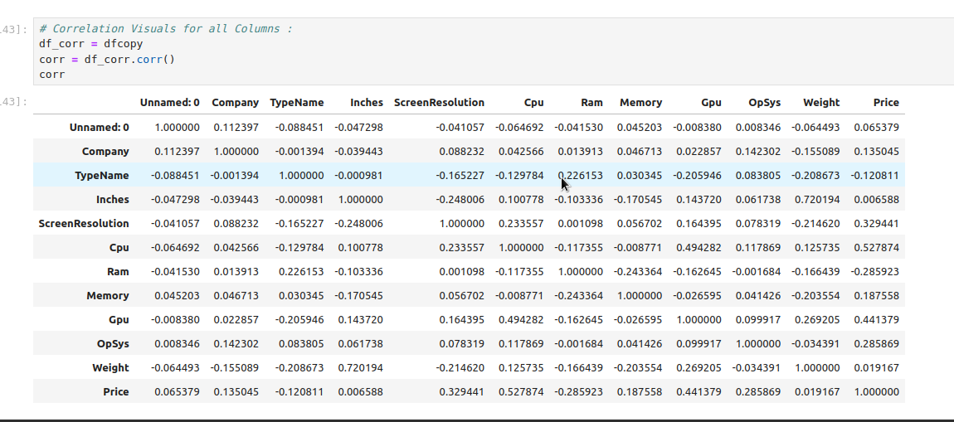

Slide 13
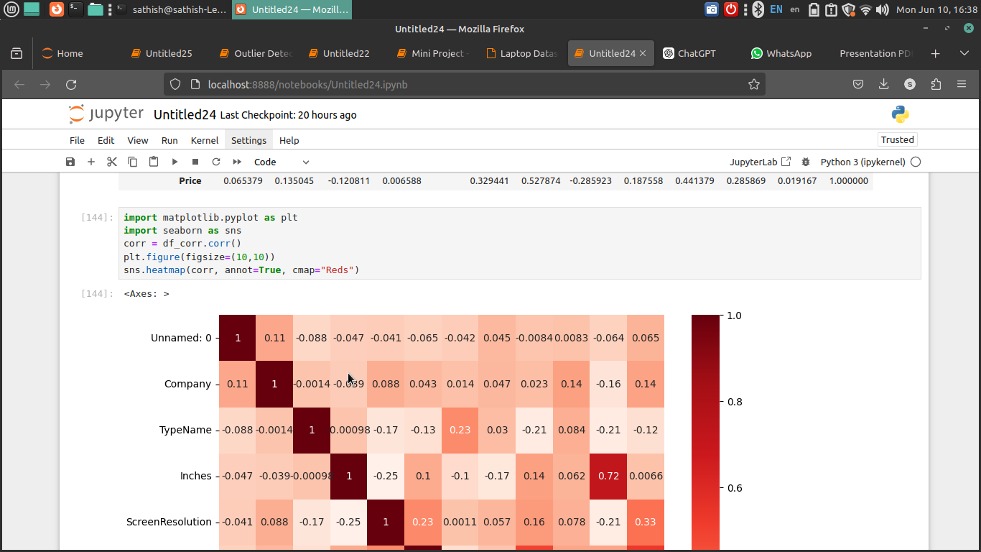
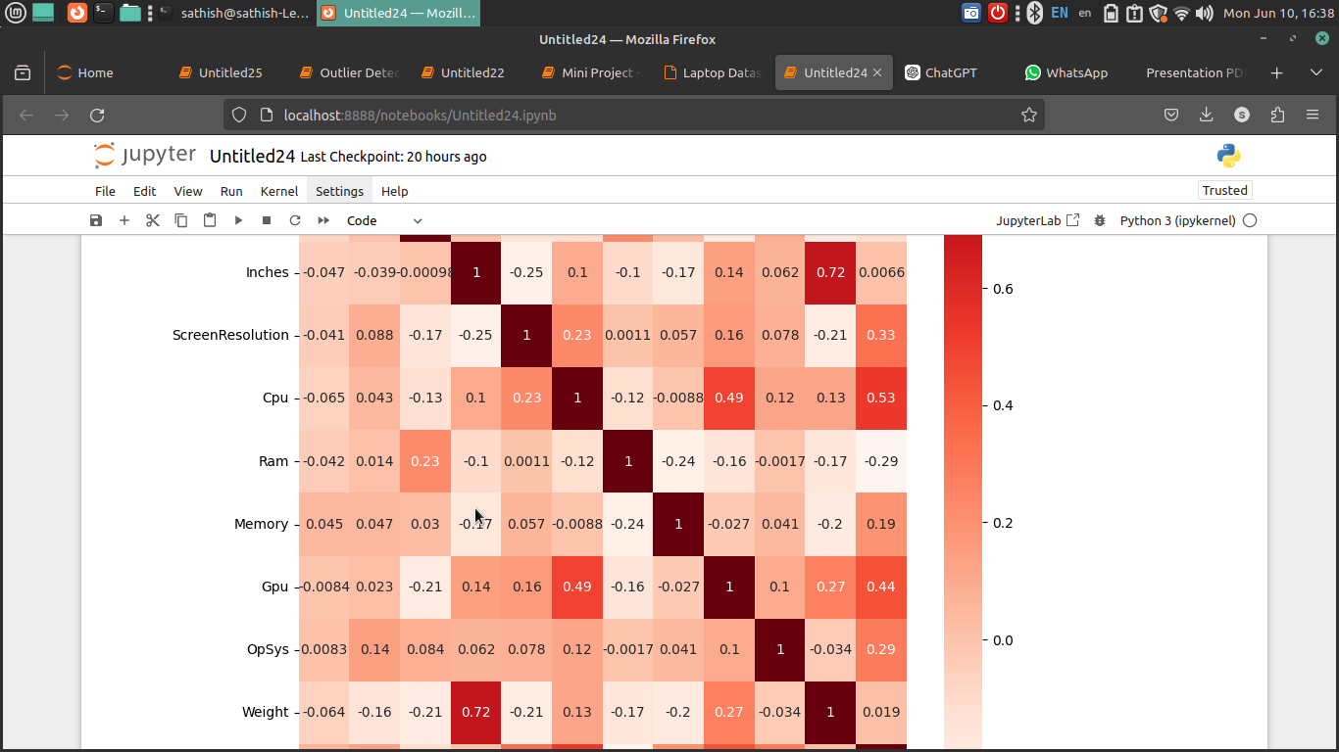
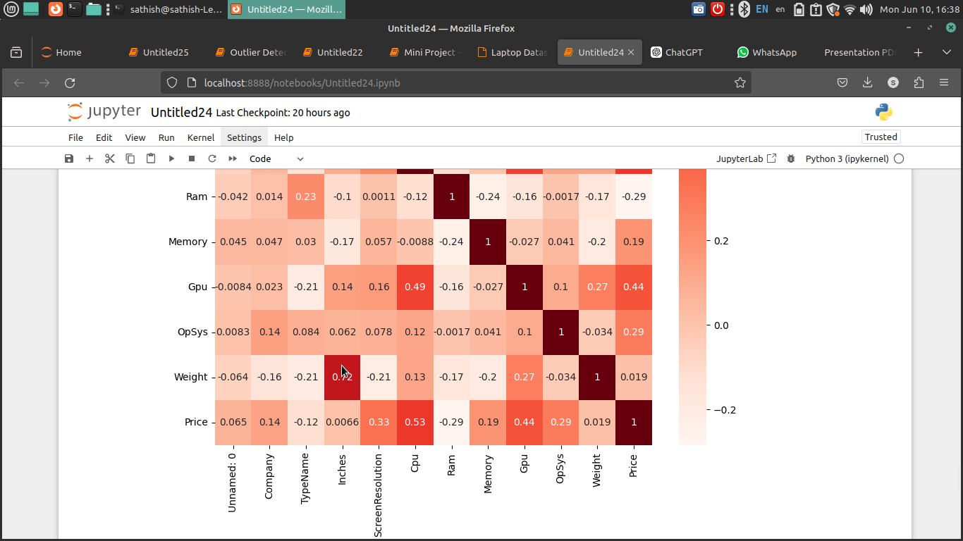

Slide 14
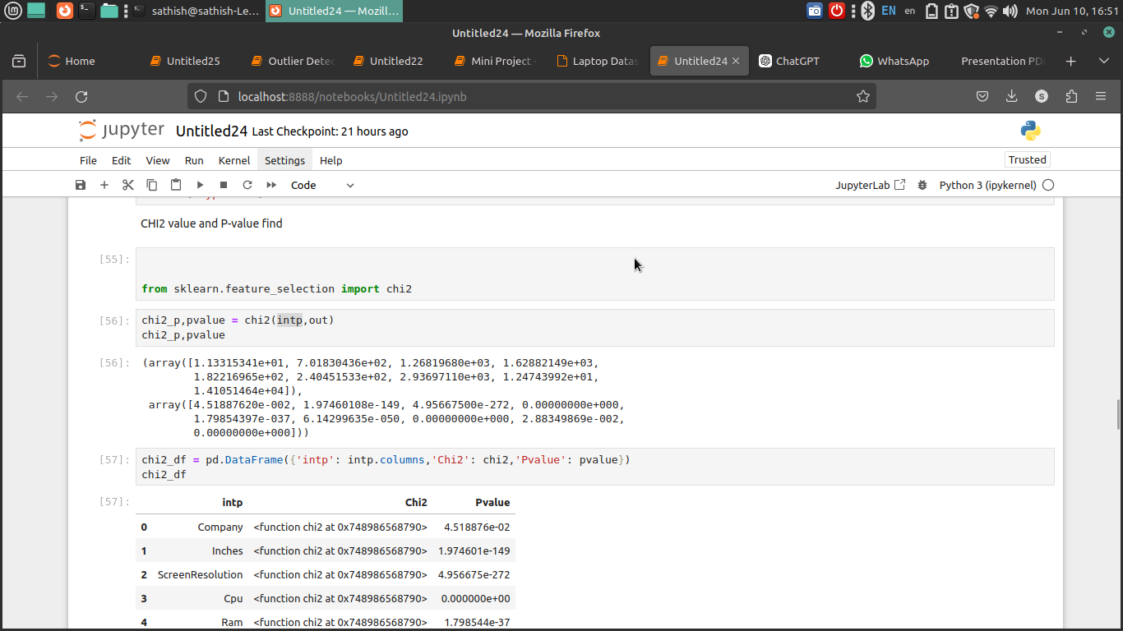
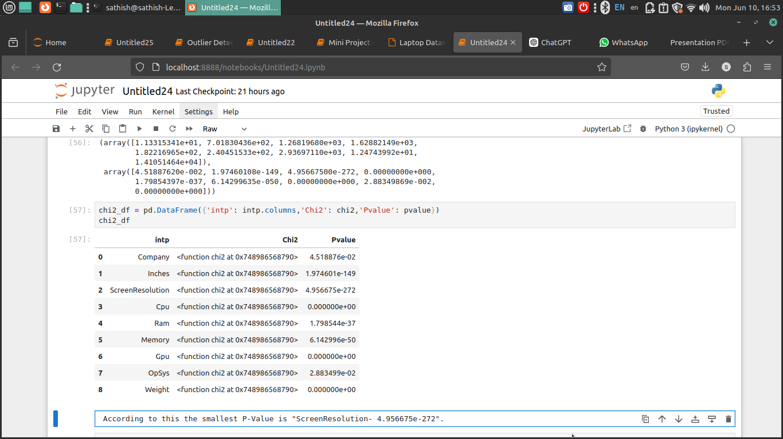
CHI2 and P-Value

Slide 15
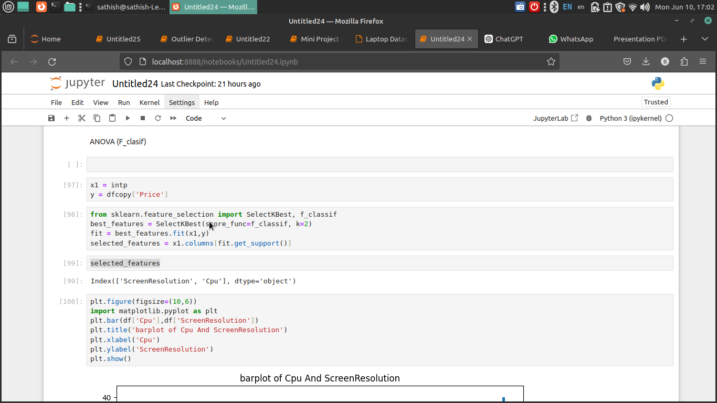
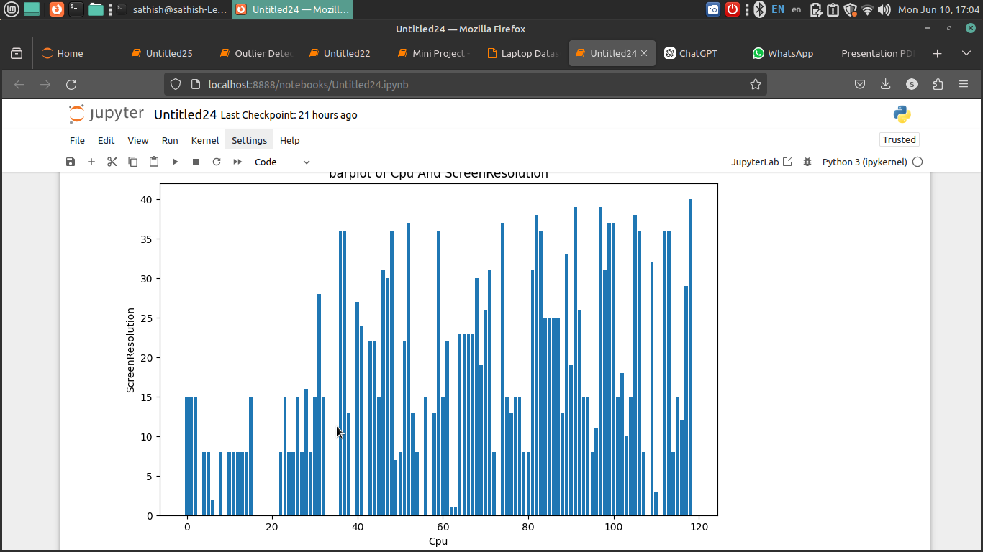
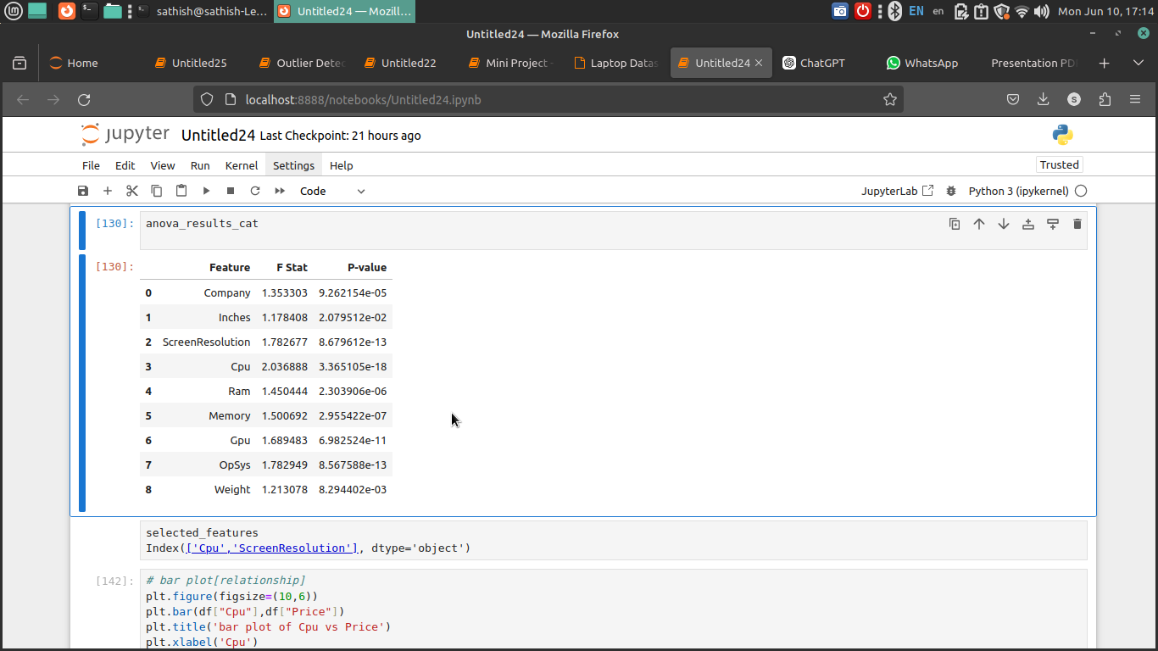
ANOVA(IF_Classif)

Slide 16
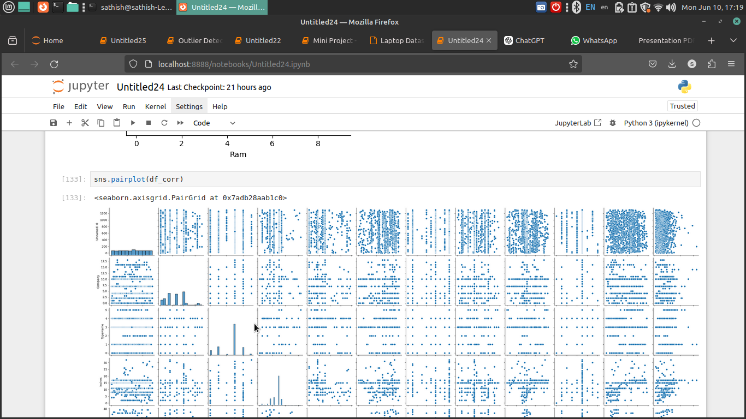
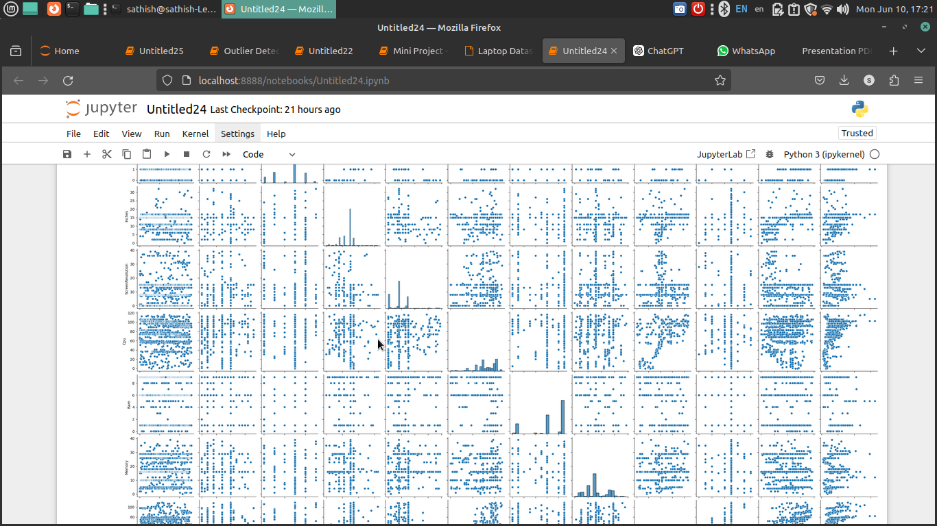

Slide 17
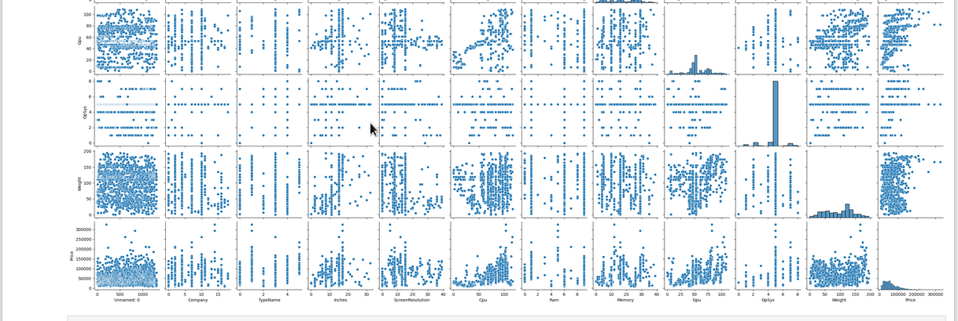

Slide 18
Recommendations
Trends:
Technological advancements (new CPU generations) significantly impact pricing.
Consumer preference leans towards lightweight and high-performance laptops.
focus in (CPU,RAM,Screenquality,Price,lightwight)
Recommendations:
Product Differentiation: Focus on unique features like battery life or build quality.
Pricing Strategy:
Competitive pricing in mid-range segment could capture more market share.
Marketing:
Highlight unique specifications and brand strengths in promotions.

